Slide 1

Introduction to AI Problem Solving by Searching SY B.Sc. (CS)
Semester IV
Poornima .N
Assistant Professor, Department of IT/CS
1

Slide 2

2 What’s in Unit 2?
✔ Solving problems by searching
✔ Performance evaluation
✔ time/space complexity
✔ completeness
✔ optimality
“How does a machine decide what to do next when it has millions of possible choices?”

Slide 3
Solving Problems by Searching

Slide 4

3 Introduction to Problem Solving by Searching
Many AI problems can be represented as search problems
A problem consists of:
Initial state
Actions
Goal state
Path cost
A solution is a sequence of actions leading from the initial state to a goal
📌 Example: Finding a route from Arad to Bucharest

Slide 5
3 What Is Search?
Search means systematically exploring possible action sequences
AI agents use search algorithms to decide:
What action to take next
Which states to explore
All possible action sequences form a search tree

Slide 6
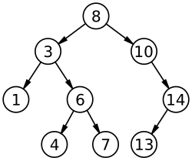

Slide 7
3 Search Tree?
A search tree represents all possible paths from the initial state
Components:
Root node → initial state
Branches → actions
Nodes → states
Each path from root to a node represents a sequence of actions
📌 Example: Arad → Sibiu → Fagaras → Bucharest

Slide 8
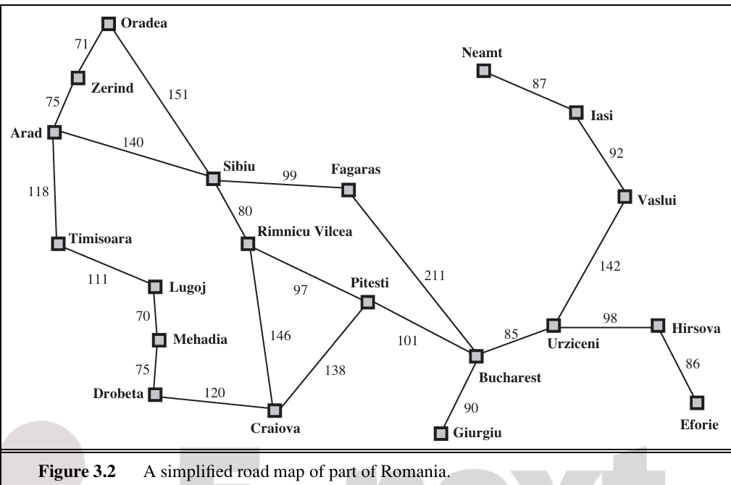

Slide 9
3 Nodes in a Search Tree?
Each node represents a data structure, not just a state.
A node contains:
State
Parent
Action
Path cost
⚠️ Node ≠ State

Slide 10
3 Node Data Structure?
For every node n, we store:
n.STATE → World state (e.g., In(Sibiu))
n.PARENT → Node that generated this node
n.ACTION → Action taken from parent
n.PATH-COST (g(n)) → Total cost from initial state to this node

Slide 11
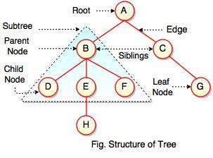

Slide 12
3 Why Parent Pointers Are Needed
Parent pointers connect nodes into a tree
When a goal is found:
Follow parent pointers back to root
Extract the action sequence
This gives the solution path

Slide 13
3 Creating Child Nodes
Child nodes are generated using the CHILD-NODE function
New state = Result of applying action
Parent = current node
Path cost = parent cost + step cost
📌 This is how the search tree grows

Slide 14
3 Expanding a Node
Expanding a node means:
Applying all legal actions
Generating all successor states
Example:
Expanding Arad generates:
Sibiu
Timisoara
Zerind

Slide 15
3 Leaf Nodes
A leaf node is a node:
That has been generated
But not yet expanded
Leaf nodes are candidates for future expansion

Slide 16
3 Frontier (Open List)
Frontier = set of all leaf nodes
Represents nodes waiting to be expanded
Search algorithms differ in how they choose a node from the frontier
📌 Frontier is also called Open List

Slide 17
3 Frontier (Open List)
Leaf nodes are the options, the frontier is the option list, and the search algorithm decides which option to try next.
Algorithm | Which leaf node is chosen?
BFS | Oldest node
DFS | Newest node
UCS | Lowest cost node

Slide 18
4 🧠 ONE-LINE MEMORY TRICK
Search Tree → structure of possibilities
Node → record with memory
Expand → generate children
Leaf → not expanded yet
Frontier → all leaves together

Slide 19
Tree-Search Algorithm

Slide 20
4 Why Do We Need Graph Search?
Tree Search may explore the same state multiple times
Causes redundant paths and wasted computation
Solution: Remember visited states

Slide 21
4 Tree Search vs Graph Search
Tree Search | Graph Search
May repeat states | Avoids repeated states
No memory of visited nodes | Uses explored set
Less efficient | More efficient

Slide 22
7 Graph Search Algorithm
Start with initial node in frontier
Remove a node from frontier
Add it to explored set
Expand node and generate children
Discard repeated states
Stop when goal is found

Slide 23
4 Child Node Generation
function CHILD-NODE(problem, parent, action) returns a node
STATE = problem.RESULT(parent.STATE, action)
PARENT = parent
ACTION = action
PATH-COST = parent.PATH-COST + problem.STEP-COST(parent.STATE, action)

Slide 24
4 Frontier and Queues
Queue Type | Behavior
FIFO Queue | First-in, first-out → expands oldest node first (Breadth-First Search)
LIFO Queue | Last-in, first-out → expands newest node first (Depth-First Search / Stack)
Priority Queue | Expands node with highest priority according to an evaluation function (e.g., A*)

Slide 25
4 Example:
Frontier = [A, B, C]
BFS (FIFO) → Pop A
DFS (LIFO) → Pop C
UCS (Priority) → Pop node with lowest path cost
So the choice of queue type defines the behavior of the search algorithm.

Slide 26
4 Explored Set (Closed List)
Prevent revisiting the same state multiple times
Avoid loops and redundancy
Implementation:
Use a hash table → fast lookup, O(1) average time

Slide 27
7 Problem: State Equality
Sometimes states look different but are the same logically:
Example:
{Bucharest, Vaslui, Urziceni}
{Urziceni, Bucharest, Vaslui}
These must be considered identical.

Slide 28
4 Canonical Form
Represent each state in one unique standard way
✔ Sorted list
✔ Bit-vector
✘ Unsorted list
This avoids storing duplicates and prevents unnecessary expansions.

Slide 29
Measuring Problem-Solving Performance

Slide 30
4 When evaluating a search algorithm, we consider four main criteria:
Completeness
Will it always find a solution if one exists?
Example:
BFS → ✅ Complete
DFS → ❌ May fail in infinite spaces
Optimality
Will it find the best solution?
“Best” = shortest path, lowest cost, etc.

Slide 31
4 When evaluating a search algorithm, we consider four main criteria:
Time Complexity
How many nodes are generated during the search
Measured as number of node expansions, not real time
Space Complexity
How much memory is required
Maximum nodes stored = frontier + explored set

Slide 32
4 1. What is Completeness?
If a solution exists, is the algorithm guaranteed to find it?"
If the answer is Yes, the algorithm is Complete

Slide 33
4 The Analogy: The Treasure in the Library
Imagine you are looking for a specific book (The Goal) in a library.

Slide 34
4 The Analogy: The Treasure in the Library (The BFS Approach)
You check every single book on the first shelf, then every book on the second shelf, and so on. Even if the library is huge, if the book is there, you will eventually touch it.

Slide 35
4 The Analogy: The Treasure in the Library (The DFS Approach)
You pick one corner and follow the shelves deeper and deeper into the basement. If the basement goes down forever (infinite stairs), you might keep walking down those stairs forever and never see the book sitting on the ground floor.

Slide 36
4 The Comparison
Algorithm | Is it Complete? | The Reason
BFS | ✅ YES | It explores the tree level-by-level. It never skips a floor.
DFS | ❌ NO | It can get stuck in an infinite path. If one branch never ends, DFS will follow it forever and never "backtrack" to the goal.

Slide 37
4 Classroom Discussion Point
Question: "What if the state space is finite (the library has a bottom floor)? Is DFS complete then?"

Slide 38
4 2. What is Optimality?
"If there are multiple ways to solve the problem, will the algorithm find the best one?“
In AI, "Best" usually means:
The shortest path (fewer steps).
The cheapest path (less fuel or money).

Slide 39
4 The Story: The Two Pizza Shops
Imagine you are hungry. There is a Pizza Shop 2 blocks away, and another one 10 blocks away.

Slide 40
4 The Analogy: The Two Pizza Shops (The BFS Approach)
The BFS Approach: BFS looks at everything 1 block away, then everything 2 blocks away. It finds the shop 2 blocks away first. BFS is a perfectionist.

Slide 41
4 The Analogy: The Two Pizza Shops (The DFS Approach)
DFS picks a direction and runs! It might run 10 blocks, find that pizza shop, and stop. It never even realized there was a closer one just around the corner. DFS is just happy to finish.

Slide 42
4 The Comparison
Algorithm | Is it Optimal? | The Reason
BFS | ✅ YES | It explores all shallow paths before moving deeper. The first goal it hits must be the closest one.
DFS | ❌ NO | It might find a goal very deep in the tree and stop, completely missing a "better" goal that was just a few steps from the start.

Slide 43
4 Classroom Discussion Point
"Why does it matter if it's optimal? Isn't finding any exit good enough?"

Slide 44
4 3. What is Time Complexity?
"How many nodes does the AI have to create (generate) before it finds the goal?" The more nodes generated, the more work the CPU has to do.

Slide 45
4 The Variables
To calculate this, we use the three variables we learned:
b: Branching Factor (How many choices per node?)
d: Depth (How many steps to the goal?)

Slide 46
4 Why it is Exponential 𝑂(𝑏^𝑑)
Every time we go one level deeper, the work doesn't just grow—it multiplies.

Slide 47
4 Time Complexity in BFS
Time complexity = number of nodes expanded
So BFS:
Expands all nodes up to depth d
Hence Time = O(b^d)

Slide 48
4 The "3-Step" Growth (Visualizing b = 3)
Let's see how the work "piles up" as we go deeper:
Step 0 (The Start): Just 1 node.
Step 1: You explore 3 new nodes.
Step 2: Each of those 3 nodes has 3 children... So 3 x 3 = 9 new nodes.
Step 3: Each of those 9 nodes has 3 children... So 9 x 3 = 243 new nodes.

Slide 49
4 Classroom Discussion Point
Ask the class: "If you are a robot and you have 2 choices (Left or Right) at every step (b = 2) and the exit is 4 steps away (d = 4) . how many nodes are waiting for you at that 4th step?"

Slide 50
4 3. What is Space Complexity?
"How much Memory (RAM) does the AI need to keep its 'To-Do List'?"

Slide 51
4 Why DFS is O(b x m) (Linear)
DFS only needs to remember the path it is currently walking on. Once it hits a dead end, it "erases" that path from its mind and tries the next one.
The Math: O(b x m) (Linear)

Slide 52
4 The Comparison
If we have 10 choices (b=10) and the goal is 10 levels deep (d=10):
BFS "To-Do List" = 10^10 =10,000,000,000 items. (The computer explodes!)
DFS "To-Do List" = 10 x 10 =100 items. (Fits on a sticky note!)

Slide 53
4 Classroom Discussion Point
"If I have a computer with very low RAM, but a very fast processor, which algorithm should I pick? BFS or DFS?"

Slide 54
4 Practice – Can the AI Survive?
Question 1: The Time Challenge (Time Complexity)
"You are playing a game of Chess against an AI. In this game, at every turn, there are 10 possible moves (b = 10). The AI wants to look 4 moves ahead (d = 4) to find the best move."

Slide 55
4 Practice – Can the AI Survive?
Task: Using the formula O(b^d) how many total positions does the AI have to 'think about'?
A) 40 positions
B) 10,000 positions
C) 1,000 positions

Slide 56
4 Practice – Can the AI Survive?
Question 2: The Memory Challenge (Space Complexity)
"You are a robot in a massive library with 4 hallways at every junction (b = 4) The library is 100 floors deep ( m = 100) You have very little memory—you can only remember 500 things at a time."

Slide 57
4 Practice – Can the AI Survive?
Task: If you use BFS O(b^d) will you run out of memory? What if you use DFS O(b x m) ?

Slide 58
4 Summary!
Evaluation Criteria | BFS (Breadth-First) | DFS (Depth-First)
Completeness | ✅ YES | ❌ NO (Stuck in infinite loops)
Optimality | ✅ YES (Shortest path) | ❌ NO (Takes first one found)
Time Complexity | O(b^d)(Nodes in a triangle) | O(b^m) (Nodes in the whole tree)
Space Complexity | O(b^d) (Remembers the "Width") | O(b \times m) (Remembers the "Path")

